Slide 1
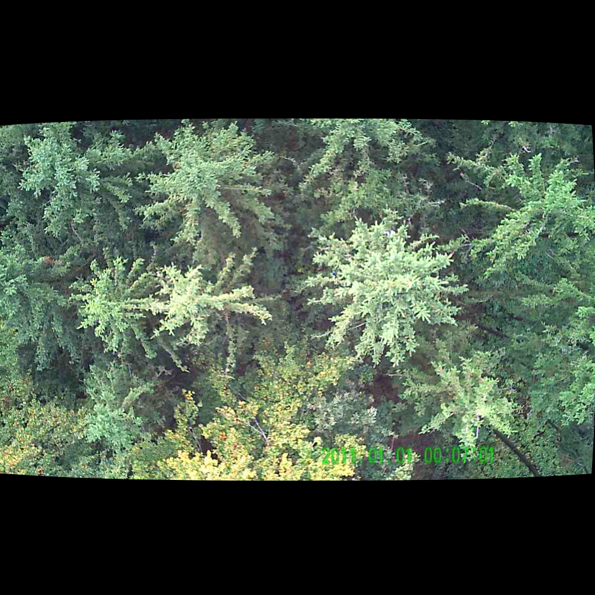
UNSUPERVISED PERSON LOCALIZATION IN WISAR Final Presentation
Team C9
Nikolas Boldis Daniel Deutsch Lisa Schneckenreiter Uta Wagner
UE Computer Vision
26th January, 2022

Slide 2
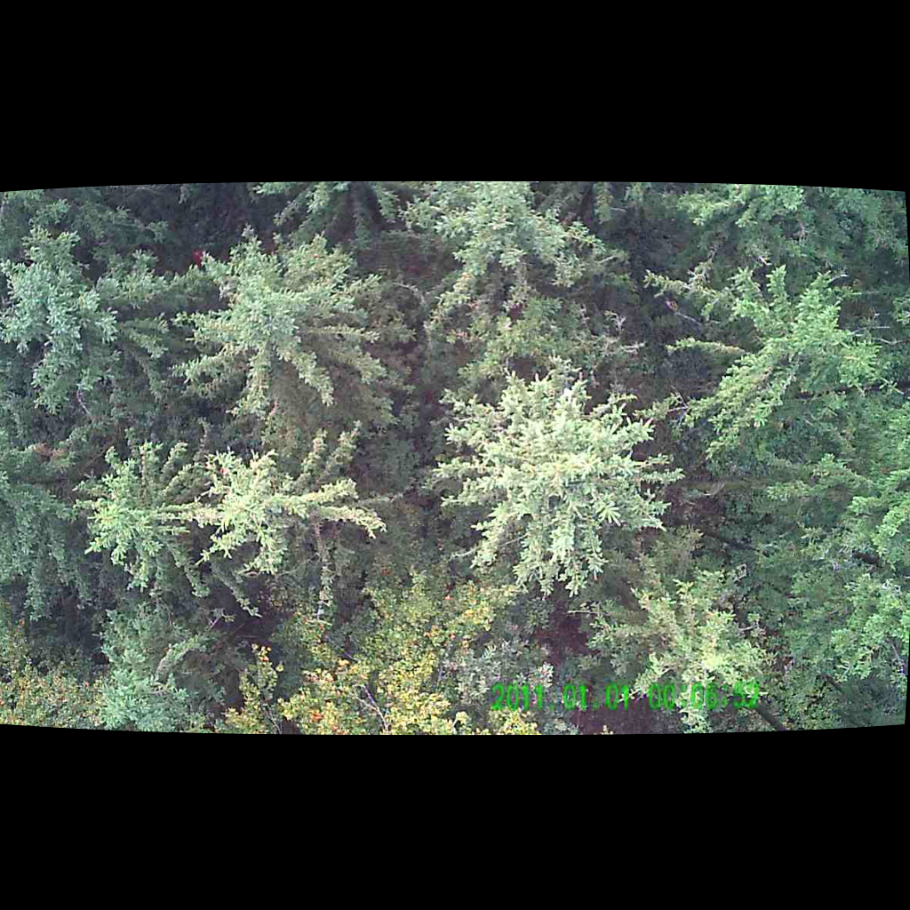
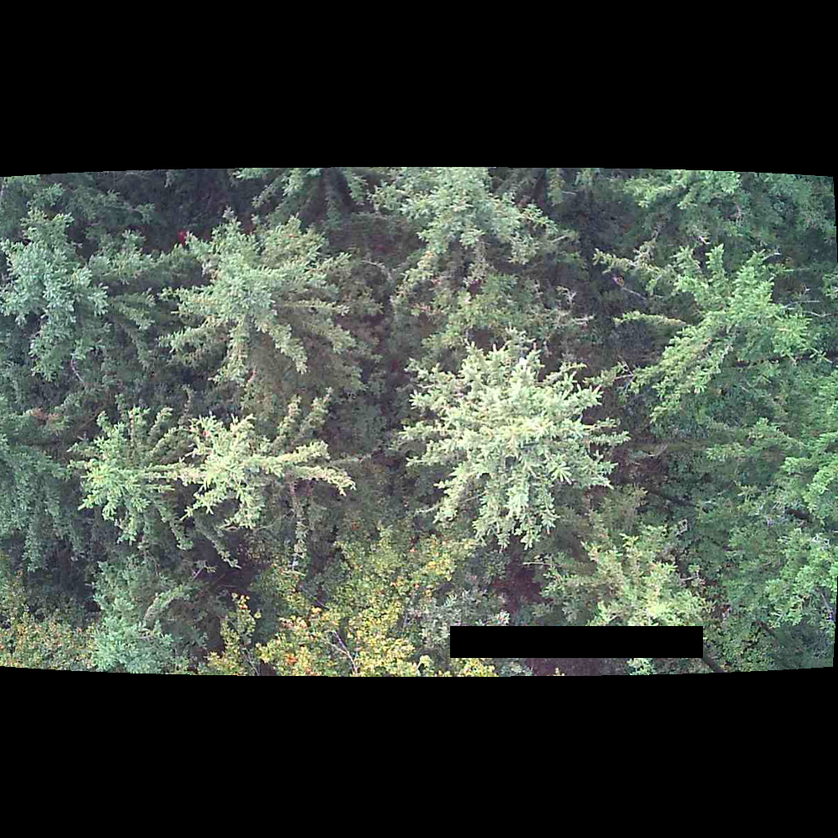

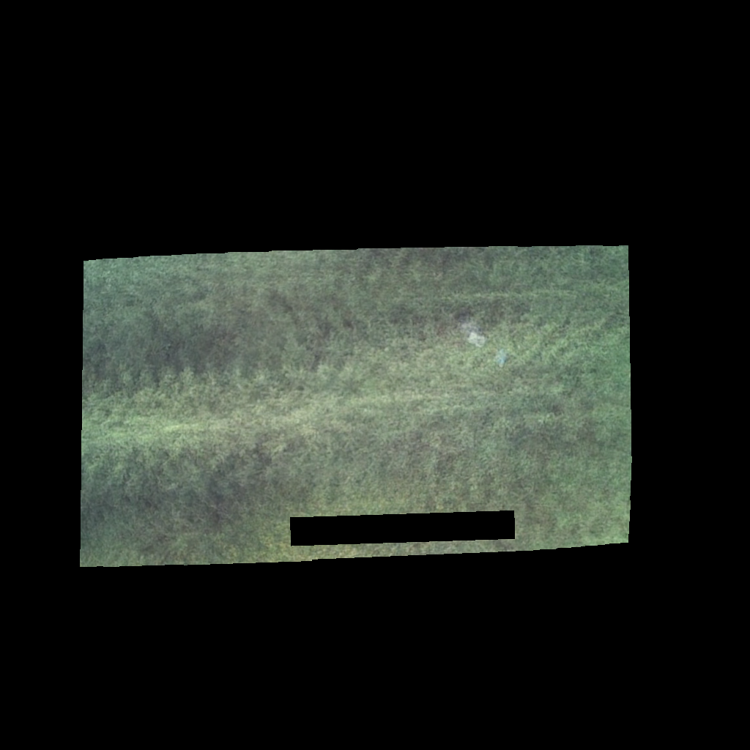
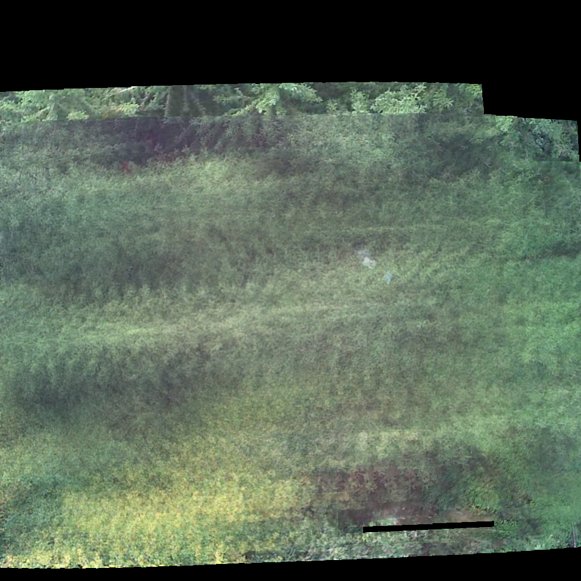
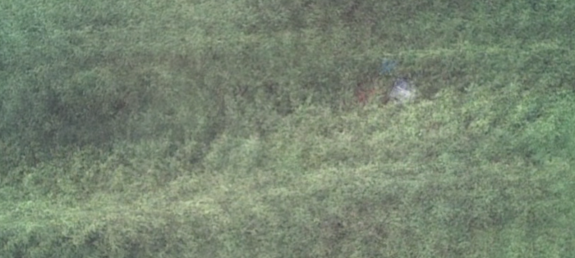
Pipeline
1. Apply mask for time stamp
2. Warp to the same perspective
3. Average over parallel recorded images
4. Remove areas not covered by all 10 images
5. Crop to
700x315 pixels
UE Computer Vision, 26th January, 2021

Slide 3
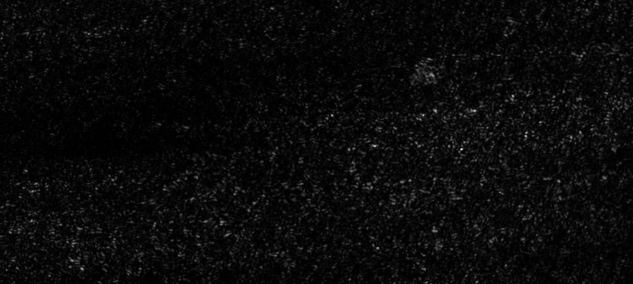
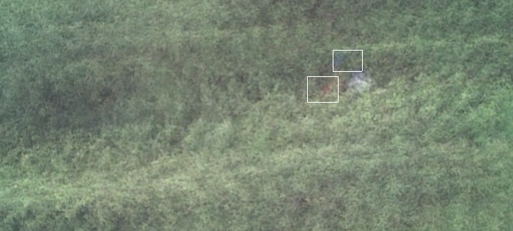
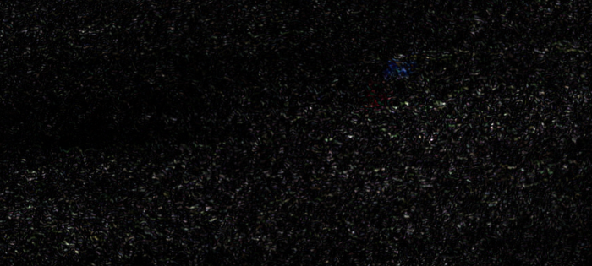
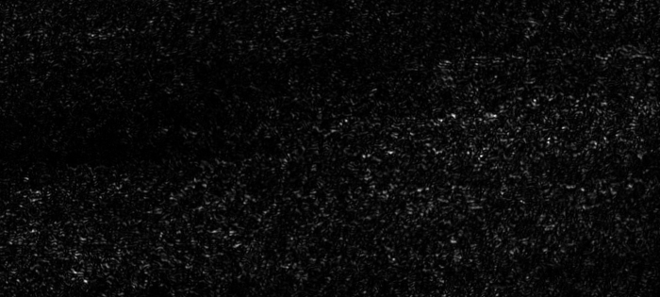
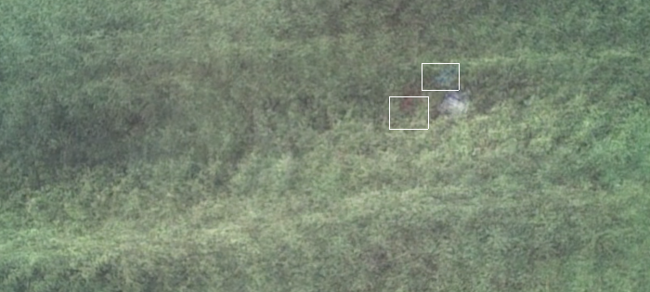
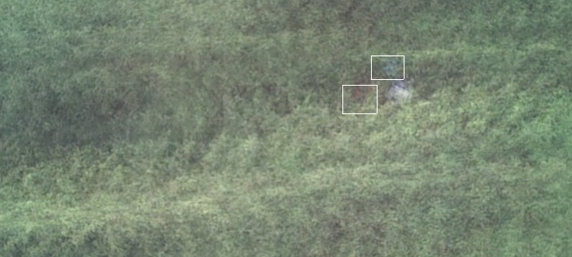
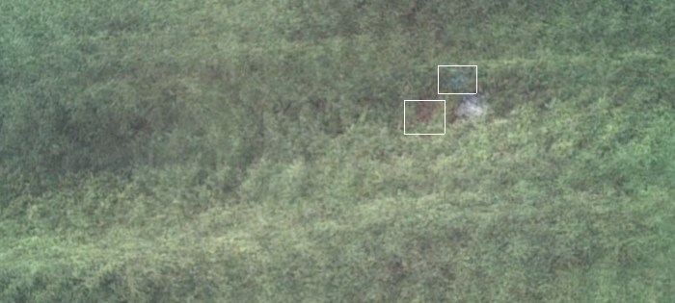


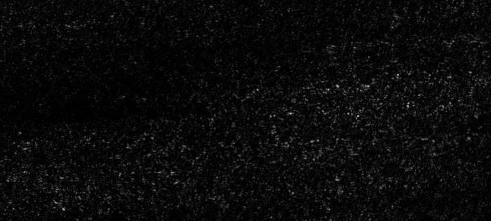
Pipeline
7. Split channels
B
6. Calculate the variance
G
R
UE Computer Vision, 26th January, 2021

Slide 4
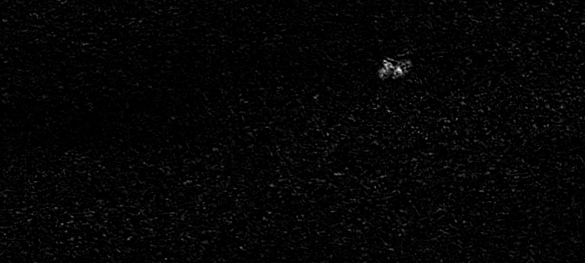
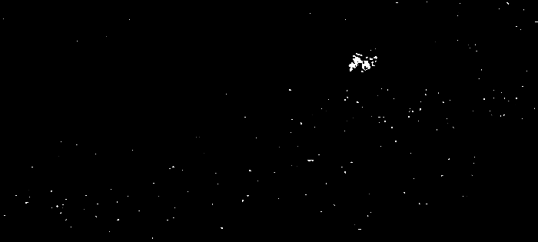
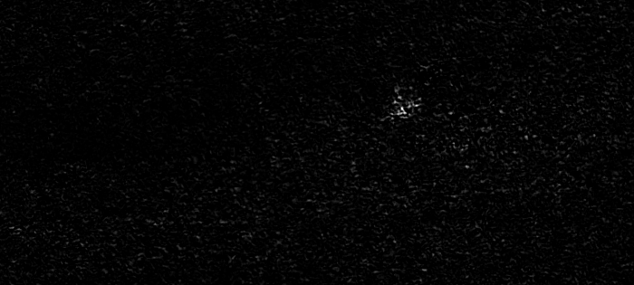
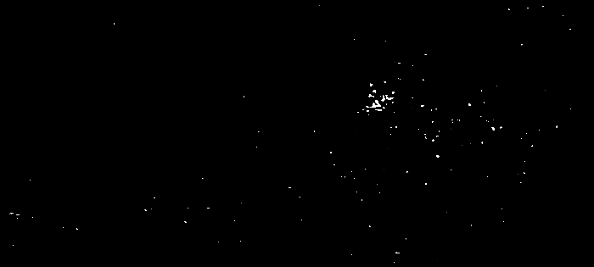
Pipeline
8. Subtract green channel & rectify
max(0, B - G)
B
9.
Contrast ↑
Brightness↓
G
R
max(0, R - G)
UE Computer Vision, 26th January, 2021

Slide 5
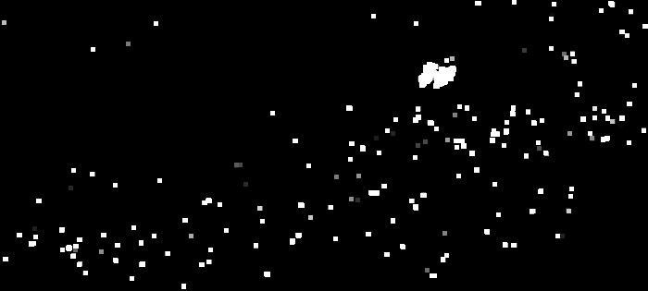
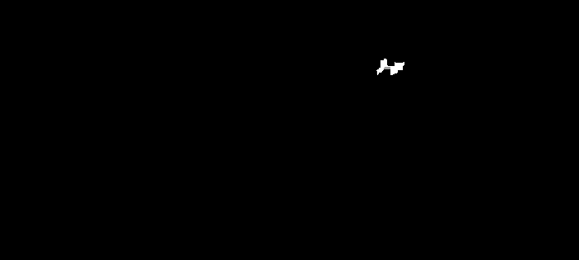


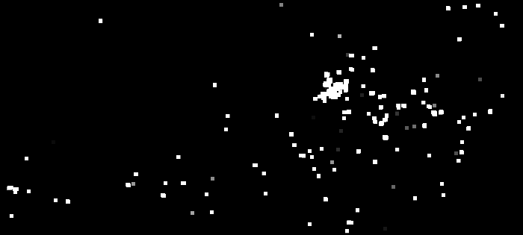

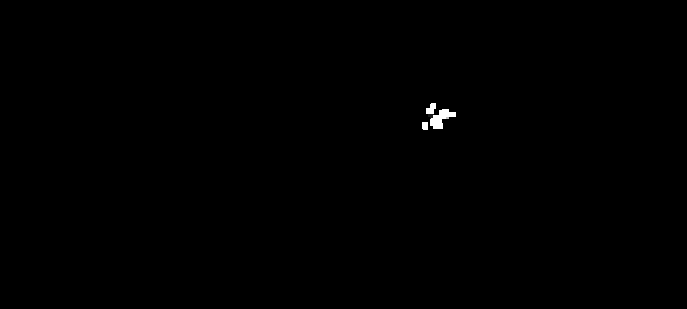

Pipeline
10. Dilation 5x5-kernel
11. Erosion 7x7-kernel
12. Dilation 5x5-kernel
13. Binarization
B-G
R-G
UE Computer Vision, 26th January, 2021

Slide 6
Get bounding boxes
OpenCV functions cv2.findContours() and cv2.boundingRect()
Pad by 2 pixels in each direction
Merge overlapping bounding boxes
Pad by 7 pixels in x and 4 pixels in y
Choose biggest bounding box of blue and red image, respectively
Remove if x<24 or y<18
If no detections → lower threshold for binary image and start from 1
Merge detections overlapping between the two images
Pad detections to a minimum size of 38x30 px
UE Computer Vision, 26th January, 2021

Slide 7
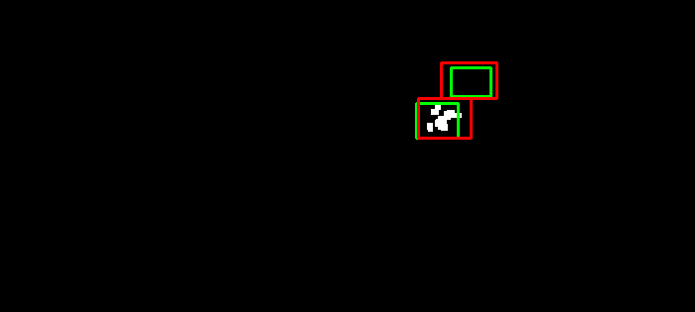
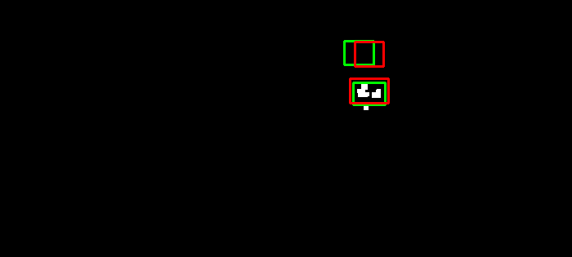
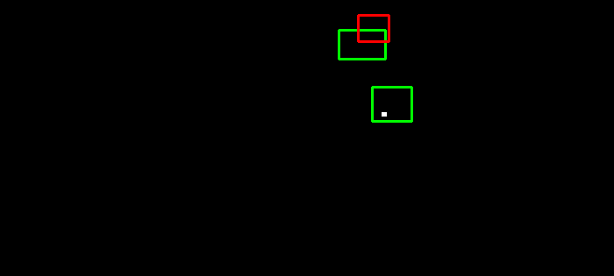
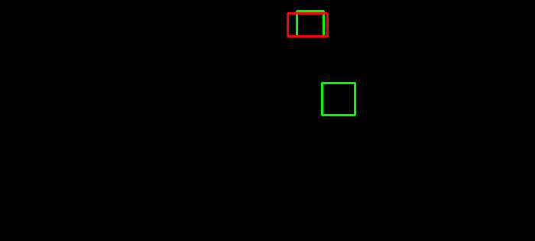
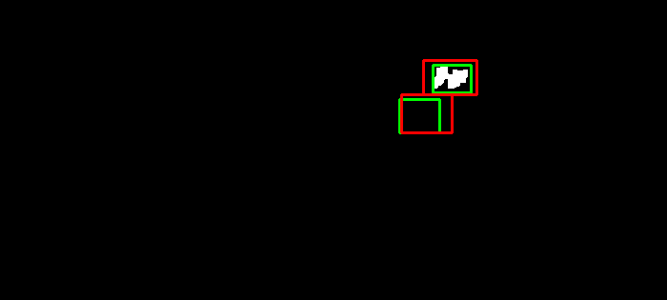
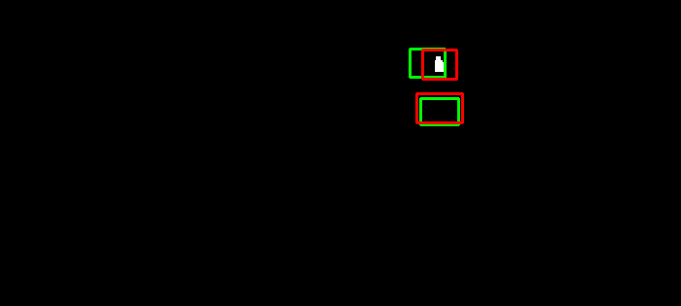
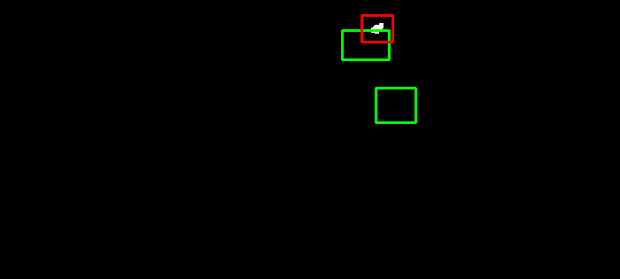
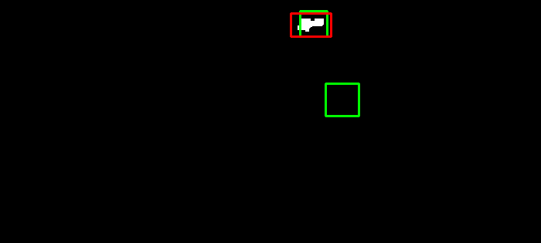
Results validation dataset – AP = 0.574
valid-2-0: [0.57, 0.64]
valid-2-1: [0.44, 0.66]
valid-2-2: [0.17, 0]
valid-2-3: [0.63, 0]
B-G
R-G
targets
detections
UE Computer Vision, 26th January, 2021

Slide 8
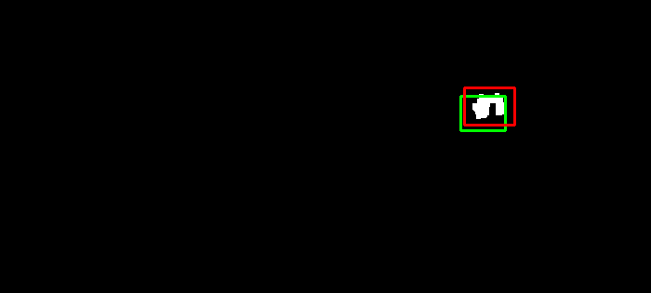
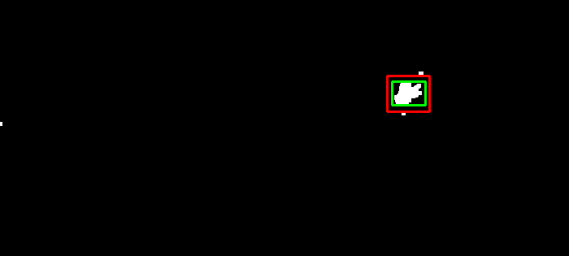
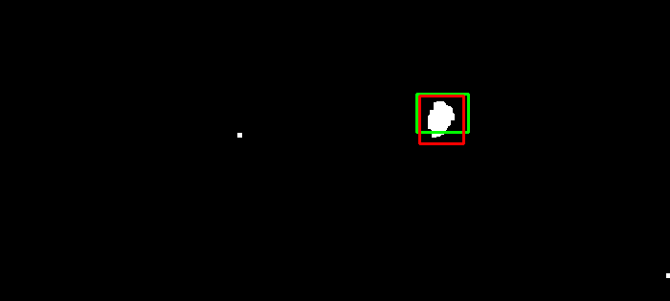
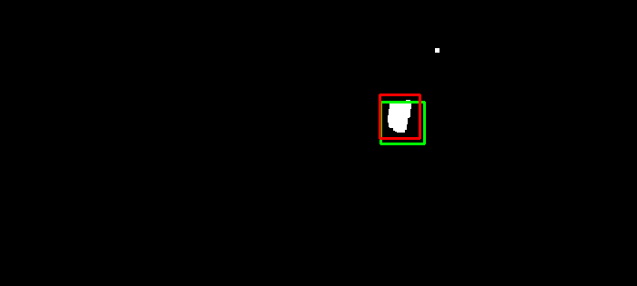
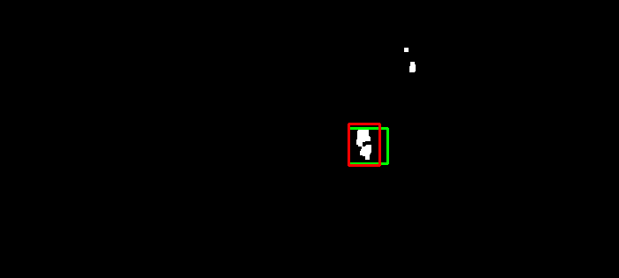
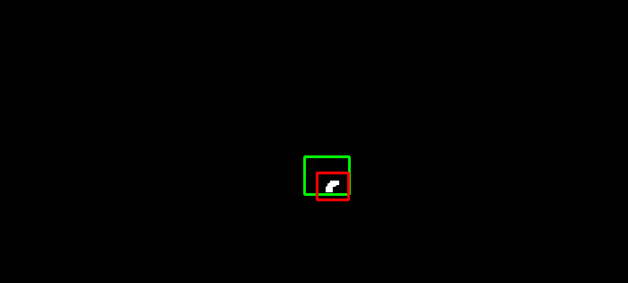
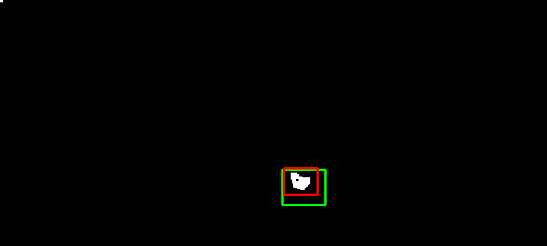
Results validation dataset – AP = 0.574
valid-1-0: 0.53
valid-1-1: 0.52
valid-1-2: 0.64
valid-1-3: 0.66
valid-1-4: 0.70
valid-1-5: 0.36
valid-1-6: 0.54
targets
detections
UE Computer Vision, 26th January, 2021

Slide 9
THANK YOU FOR YOUR ATTENTION!

